Slide 1

Summary Extraction and Sentiment Analysis.
Group 4
Mentor - Kartik

Slide 2
Team Members.
Dhanalaxmi S.
Garima Soni.
Swati vasawade.
Prafull Yadav.
Sajan Dara.

Slide 3
Business Objective.
To extract Ebook of your choice and extract summary ,categorize summary as positive, negative or neutral. Build a NLP model to achieve the said objective with accepted accuracy of 75% and above.

Slide 4
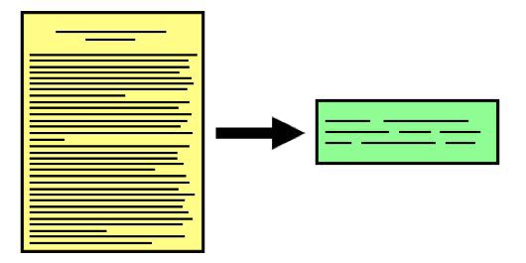
What Is Text Summarization
Text summarization is the process of creating a short, accurate, and fluent summary of a longer text document, It is the process of distilling the most important information from a source text. Automatic text summarization is a common problem in machine learning and natural language processing (NLP). Automatic text summarization methods are greatly needed to address the ever-growing amount of text data available online to both better help discover relevant information and to consume relevant information faster.

Slide 5
Steps To Summarize Text.
Text Cleaning
Sentence Tokenization
Word Frequency Table.
Summarization.

Slide 6
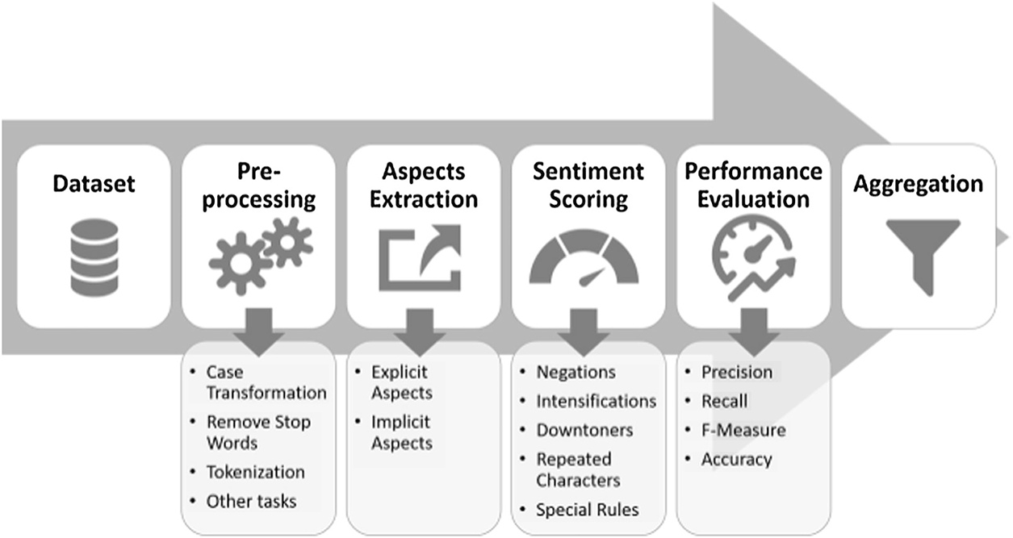
Project Workflow.

Slide 7

Dataset.
E-Book/Data :- Resisting Happiness.
Author :- Matthew Kelly.
A true story about why we sabotage ourselves, feel overwhelmed, set aside our dreams, and lack the courage to simply be ourselves. . . and how to start choosing happiness again!

Slide 8
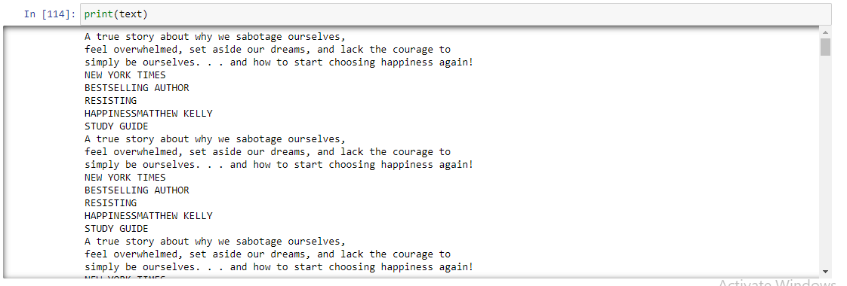
Extracted Text-Data.

Slide 9
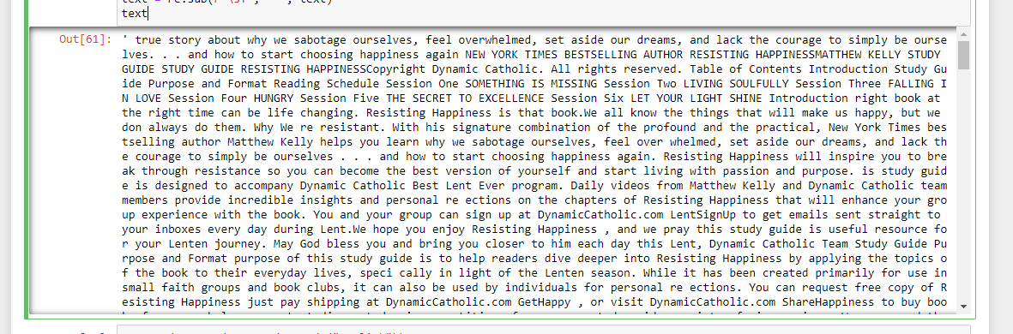
Data Cleaning/EDA.

Slide 10
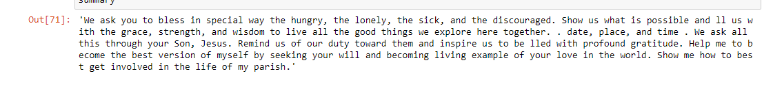
Data Summarization

Slide 11
Thank You

